Slide 1
BW/4HANA – Reporting FAQ

Slide 2
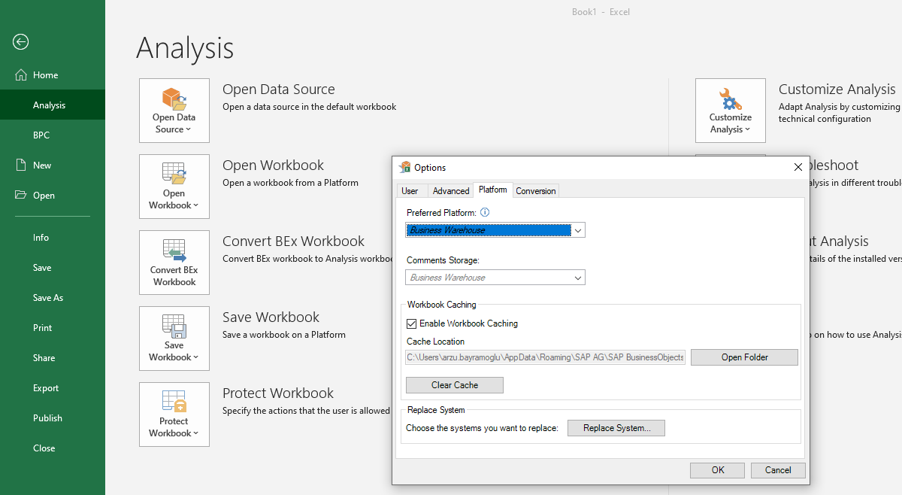
How to choose Business Warehouse Platform
Execute Analysis for Microsoft Excel, go to File -> Analysis - > Customize Analysis -> Options -> Platform : Select Business Warehouse. This is a one-time activity.

Slide 3
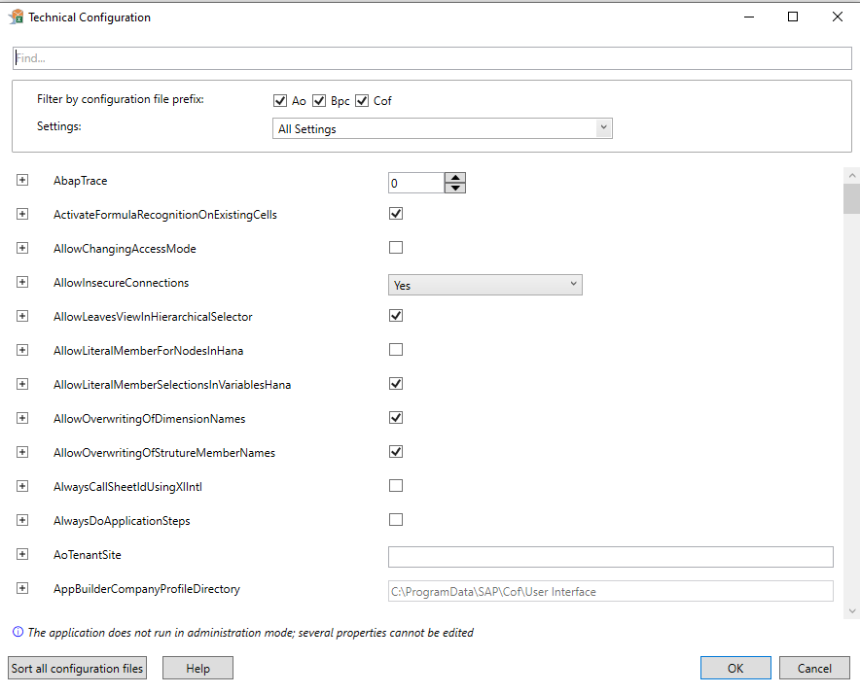
How to avoid Insecure Connection Error
File -> Analysis - > Customize Analysis ->Technical Configuration : Select «AllowInsecureConnections» as Yes. This is a one-time activity.

Slide 4
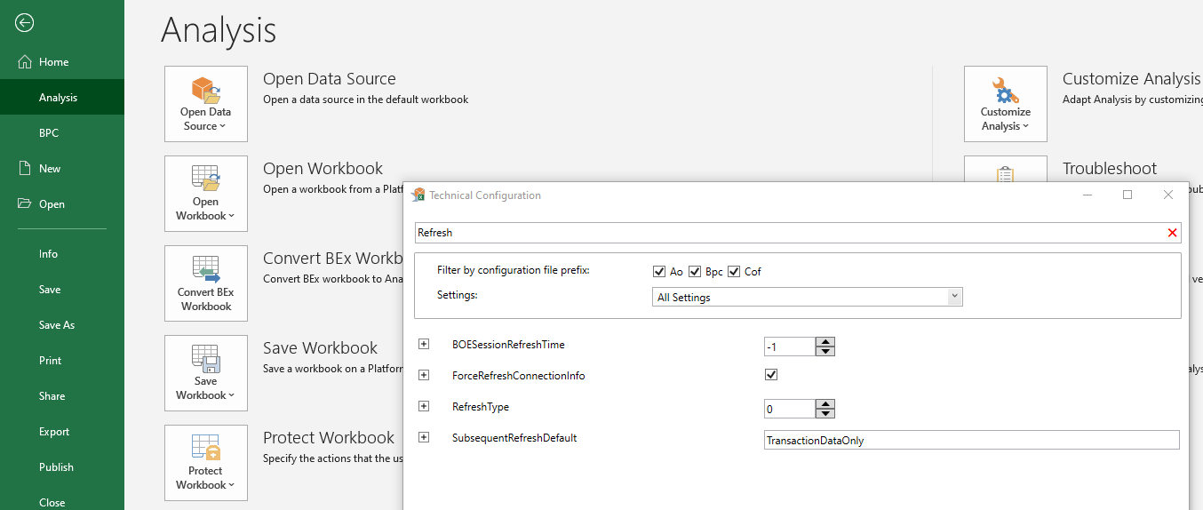
How to remove «Try with/without SNC» Alert
File -> Analysis - > Customize Analysis ->Technical Configuration : Type «Refresh» on the search box -> Tick «ForceRefreshConnectionInfo»

Slide 5
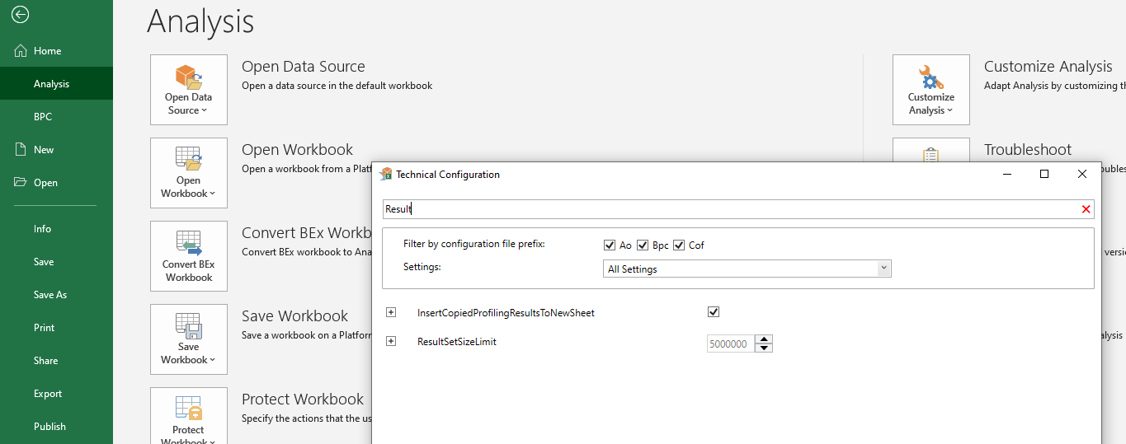
How to overcome «Size Limit Exceeded» Error
File -> Analysis - > Customize Analysis ->Technical Configuration -> Type «Result» on the search box -> Set ResultSetSizeLimit as max. 5.000.000

Slide 6
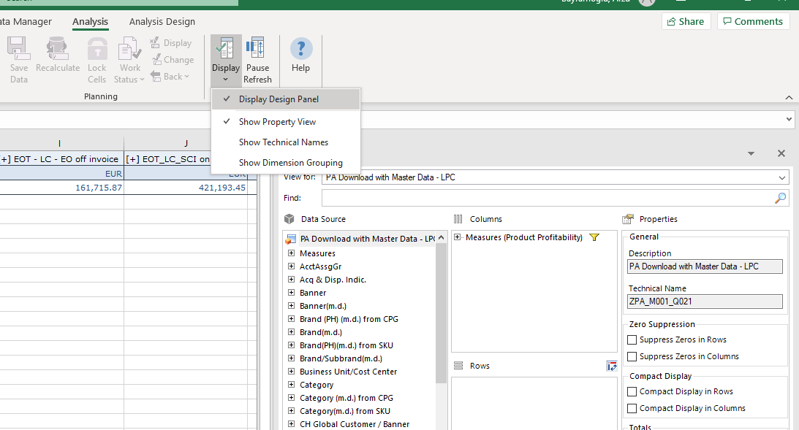
How to enable Property View
Analysis -> Display -> Select «Display Design Panel» and «Show Property View»

Slide 7
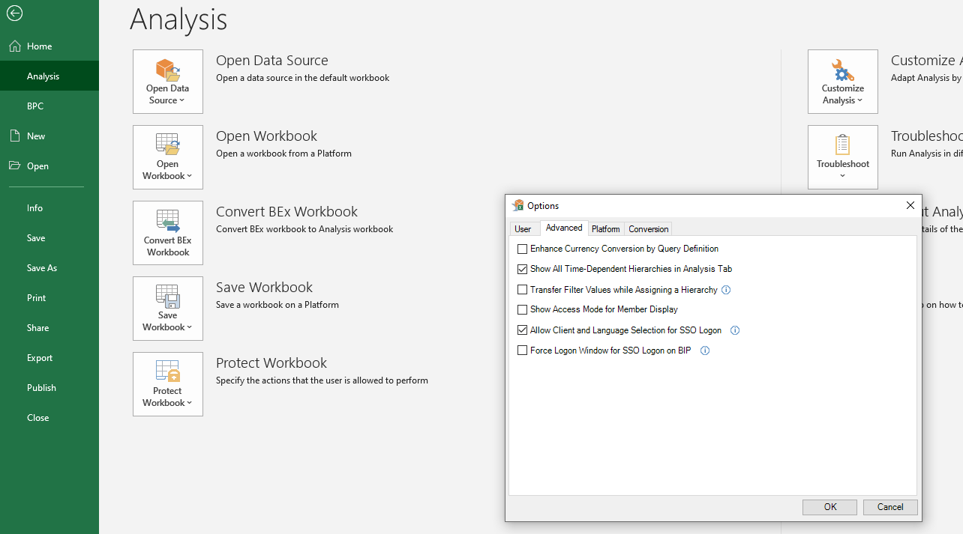
How to enable Login with different Language
File -> Analysis - > Customize Analysis -> Options -> Advanced -> Tick «Allow Client and Language Selection for SSO Logon»

Slide 8
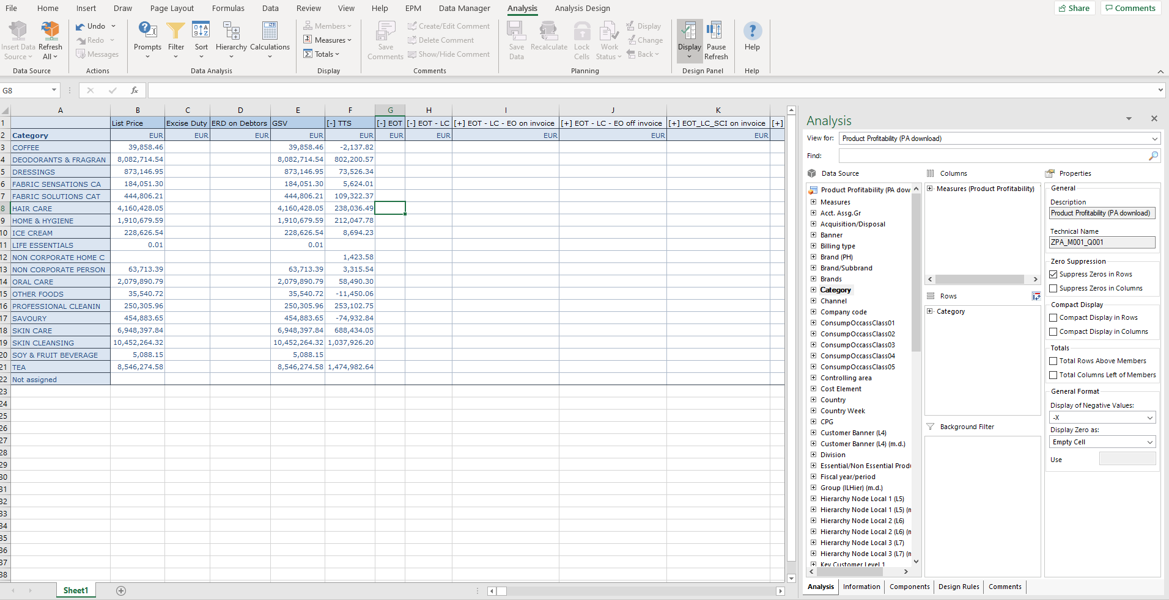
AFO Layout
Variant update, filtering, sorting etc
can be done from this menu
Filtering, drilldowns can be
done via drag drop
Output modifications such as
zero suppression can be
done via here

Slide 9
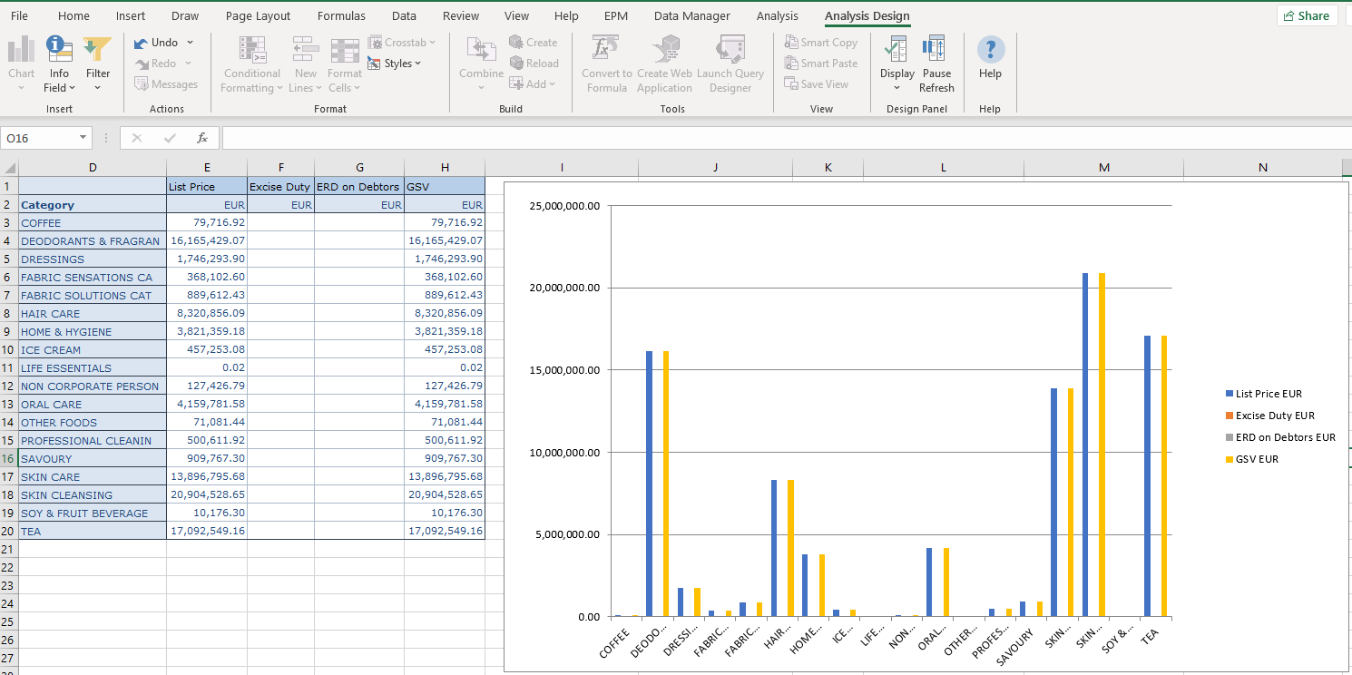
Smart Copy & Paste
Under Analysis Design tab – Smart Copy & Smart Paste,
output can be converted to a chart

Slide 10
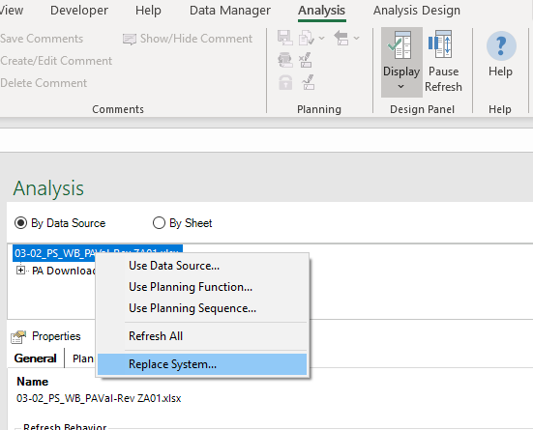
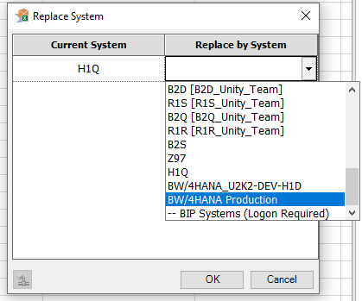
Local Workbook System Connection Update

Slide 11
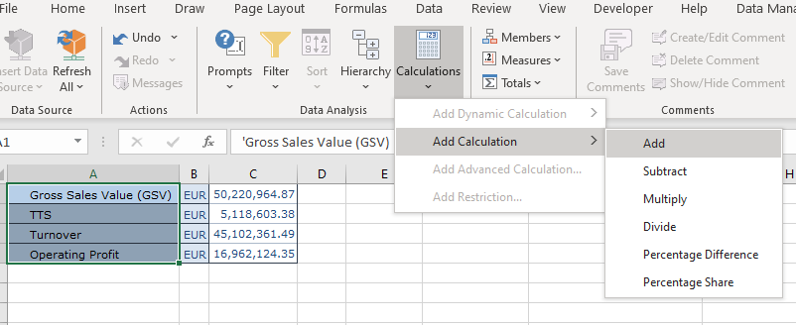
How to create Local Formula - 1
Select all the measures you want to add local formula for -> Calculations -> Add Calculation

Slide 12
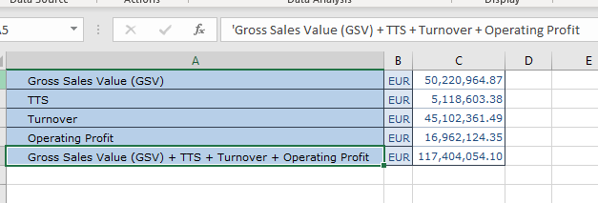
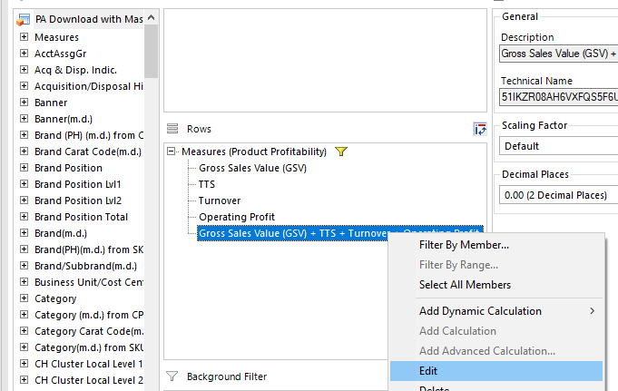
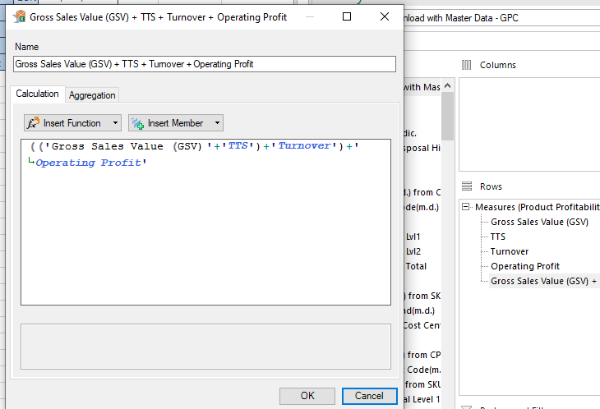
How to create Local Formula - 2
Local formula result is added at the end
Change the description or the calculation logic as following:

Slide 13
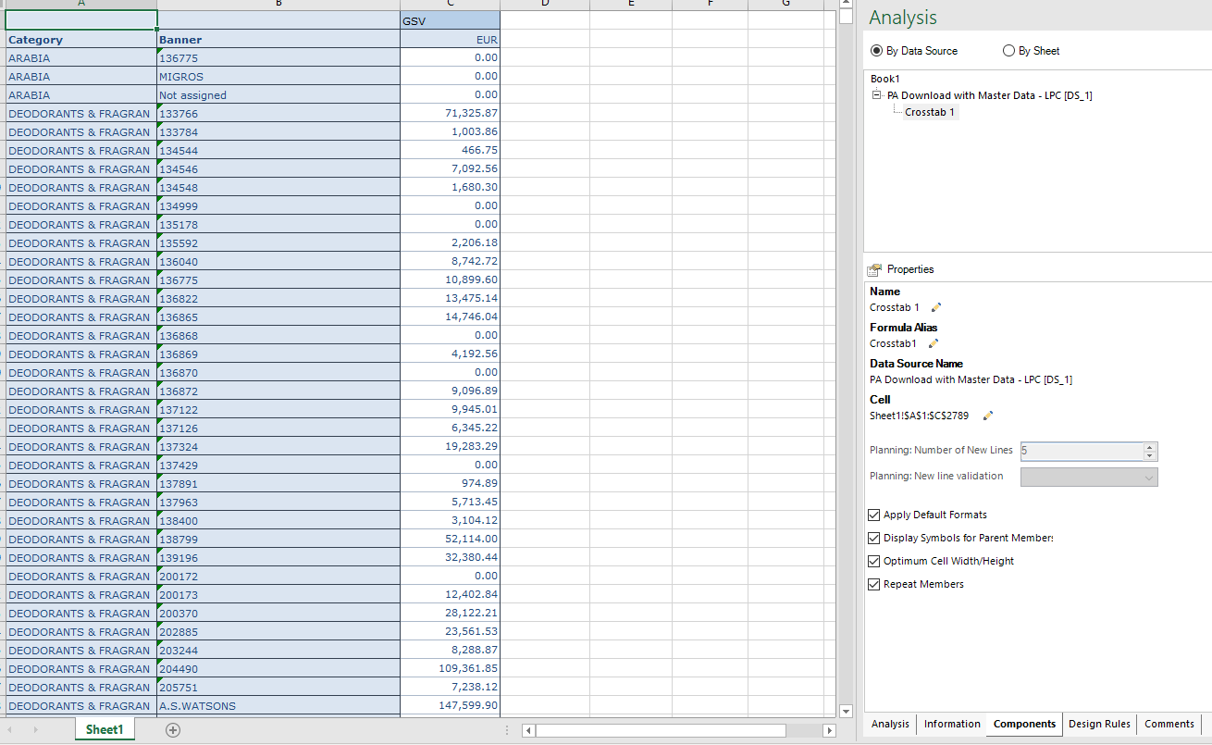
How to repeat values

Slide 14
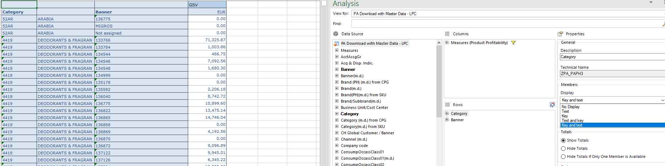
How to display key & text

Slide 15
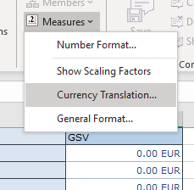
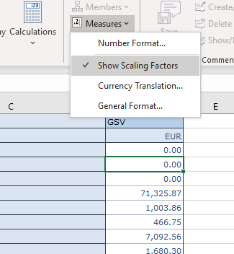
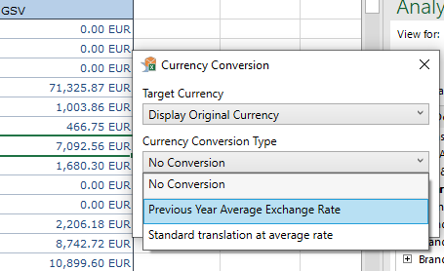
How to enable Scaling & Currency Translation

Slide 16
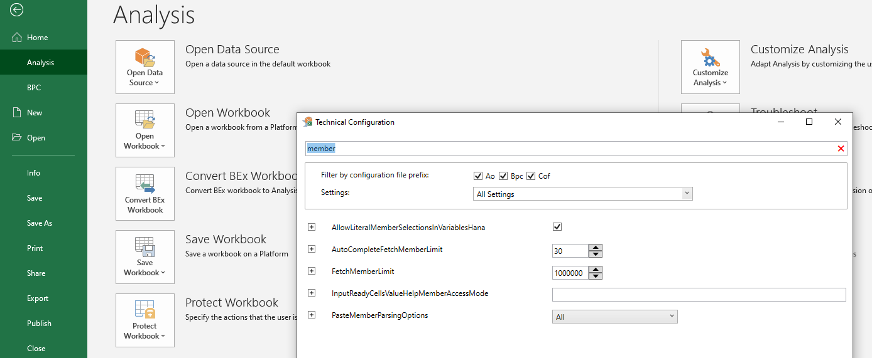
How to increase Member Display Limit for filtering
File -> Analysis - > Customize Analysis ->Technical Configuration -> Type «member» on the search box -> Set FetchMemberLimit as max. 1.000.000

Slide 17
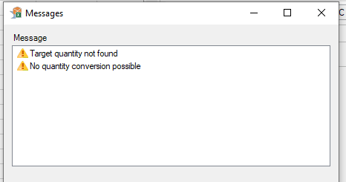
Target Quantity not found warning
Below warning comes up if the query has Quantity measure on the output; in case there is an SKU with postings having multiple Units, this warning comes up; it’s not an error but a «warning».

Slide 18
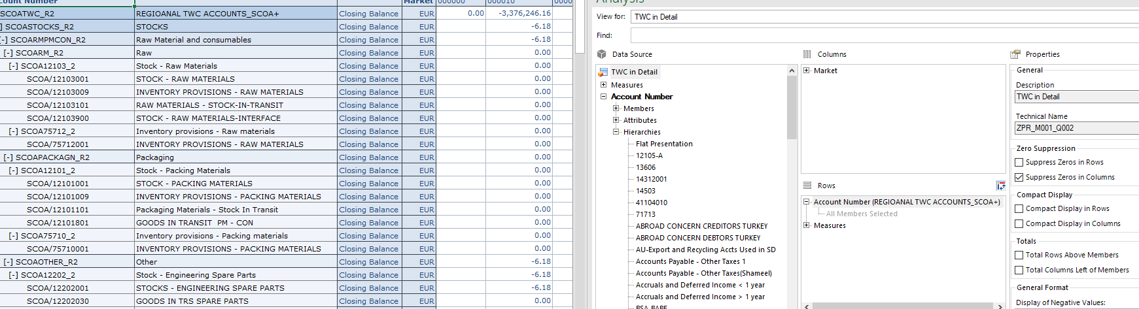
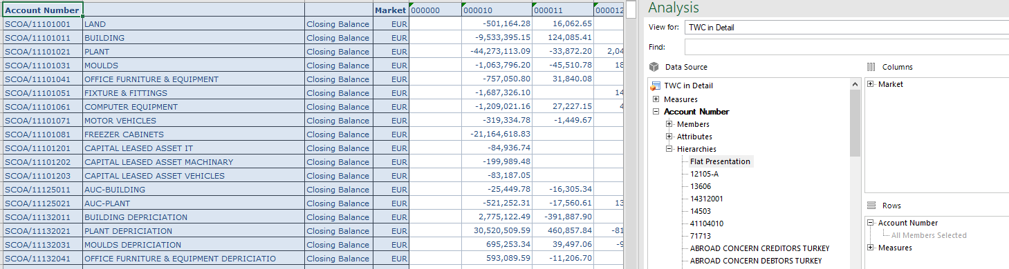
Deactivating Hierarchies – Flat Presentation
Find the object with hierarchy display, under hierarchies double click on «Flat Presentation»

Slide 19
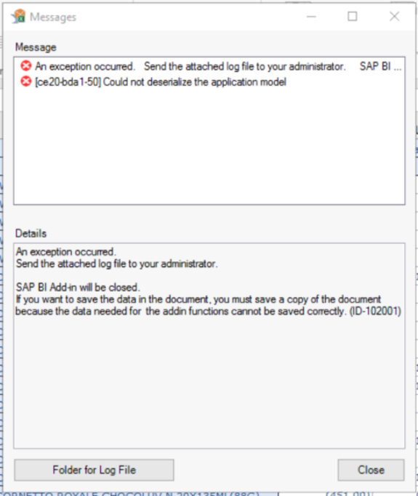
Unable to access SAP-HANA File
Local files can’t be open in AFO report

Slide 20
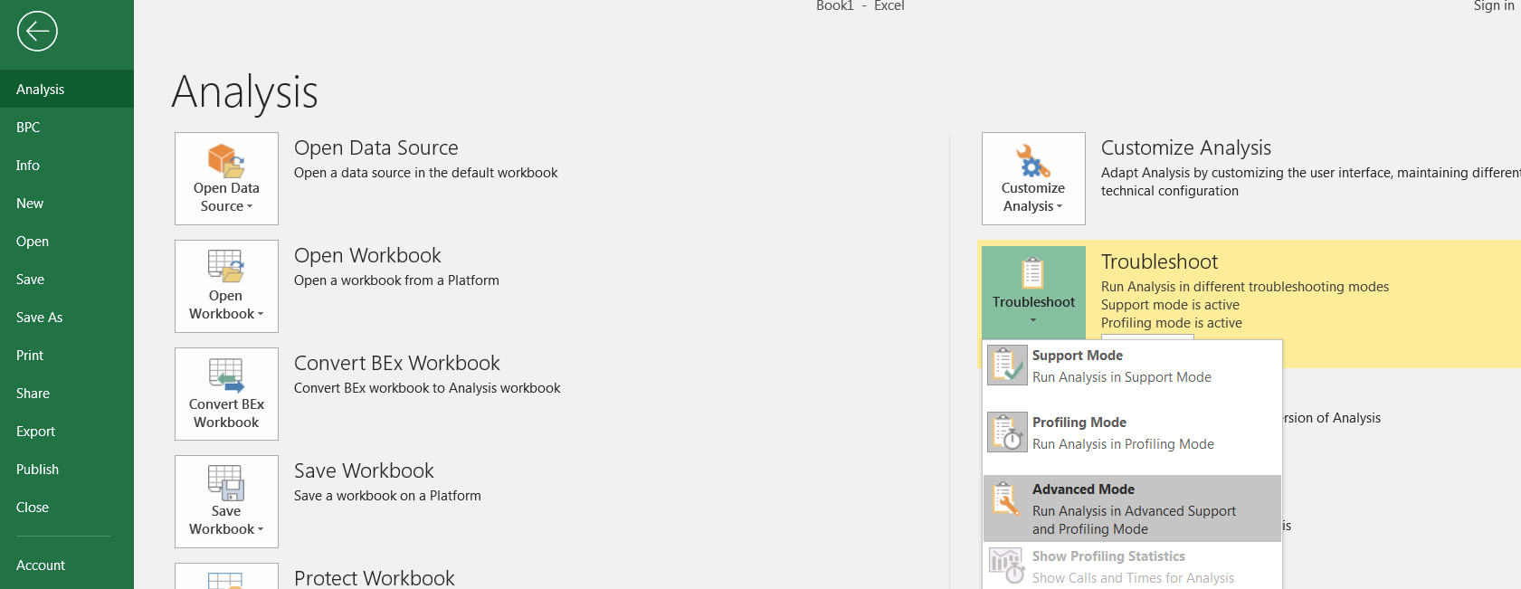
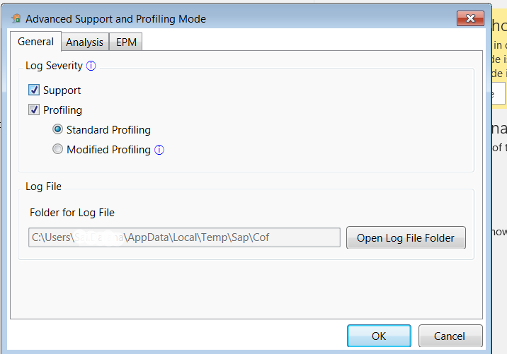
Logging and Tracing
Troubleshooting of Analysis Office issues can be done by enabling the logging mode from AO workbook. Three types tracing is available in AO - “Support Mode”, “Profiling Mode” & “Advanced Mode” .To enable tracing launch Analysis Office > File Analysis. Click on “Troubleshoot” you will see three different options.
Click “Advanced Mode”. In this mode we can define what types of logs we would like to capture. We can change the Log file location from General tab

Slide 21
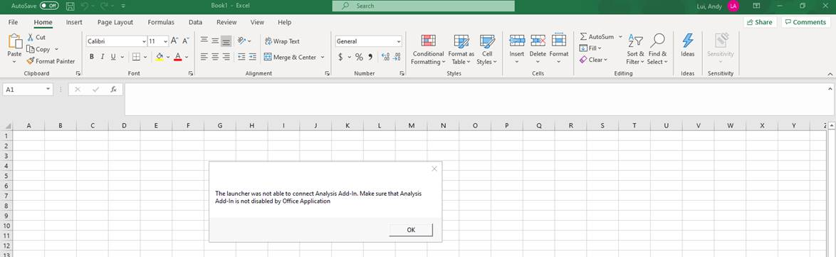
H1P is not available to refresh the data
Go To Files – Options- Add-ins and in place of highlighted option take disable items and press GO button. Select the "Addin: analysis (sapexceladdin.vsto……" and click "Enable" button then restart your application.

Slide 22
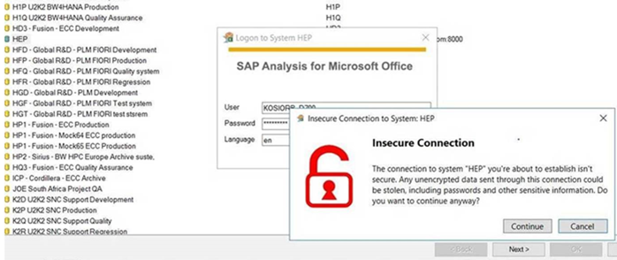
Analysis Office currently is not able to establish a connection
Check this issue with Authorization team.

Slide 23
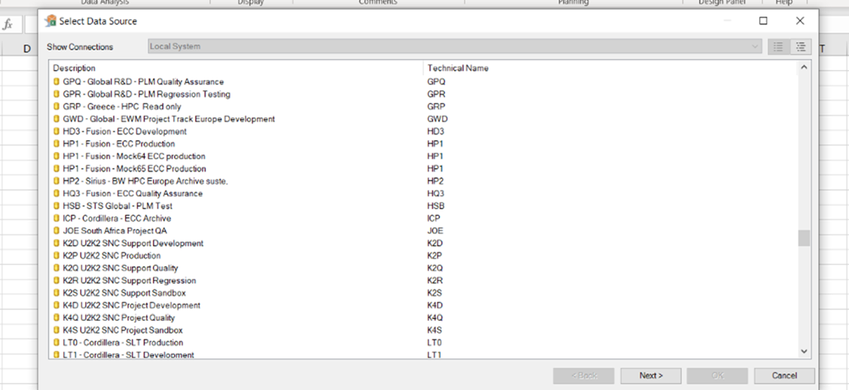
H1P System is Not Showing in AFO
Check with Authorization team regarding H1P access

Slide 24
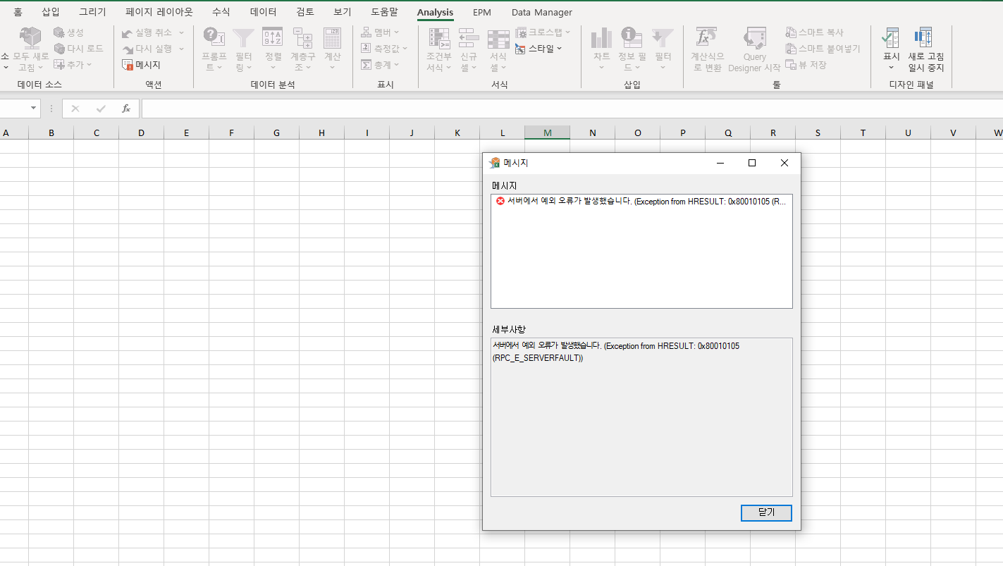
HANA - cannot access system through analysis
It is a server issue while connecting BW server through AFO

Slide 25
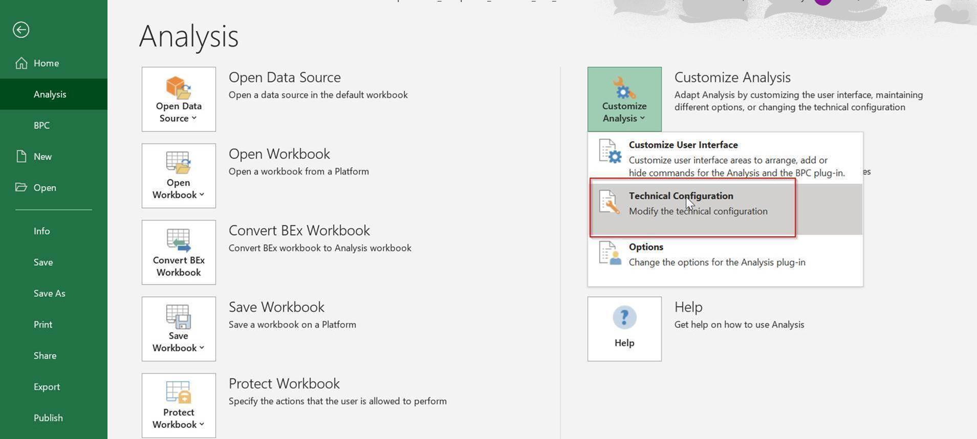
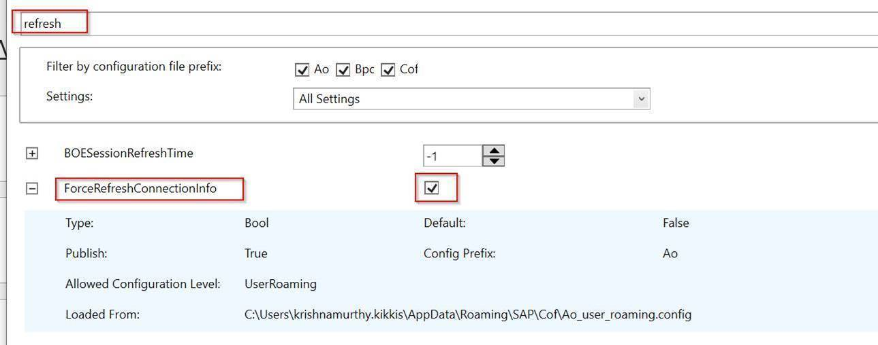
AFO Access issue
Please make sure that the following steps are configured as properly.
You should be connected to ZScaler.
The versions of MS Excel and AFO should be same (32 bit / 64 bit).
SAP GUI version should be 750 or upper.
All Excel pages should be closed.
Finally, you can try to run the AFO.
** If AFO ask client / language settings, you can type the information as below :
Client : 010
Language : EN
When Excel is opened please go to:
File → Analysis → Customize Analysis → Technical Configuration → Type “Refresh” on the top and click on the check box highlighted below

Slide 26
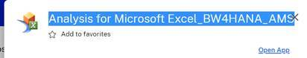
AFO Version
The correct version of AFO which is needed

Slide 27
THANK YOU

